Slide 1

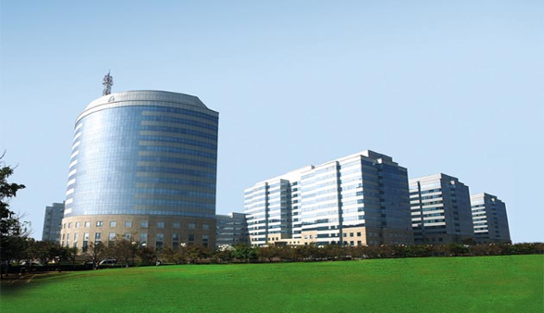

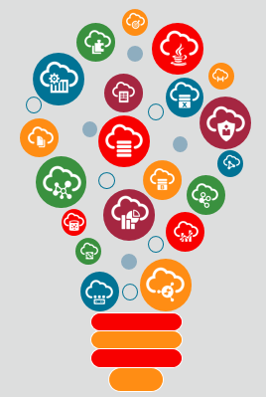
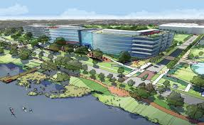
Introducing NATD Solution Engineering’s
Oracle Cloud Solution Hubs
Bangalore
Reston
Hamza Jahangir August 2017
Austin
Notes:
Title Slide.

Slide 2







Why have Oracle Cloud Solution Hubs?
Scale delivery of Industry Cloud Solutions
Packaged SE services
Harvested reusable assets
24x7 global development
Agile, best practice Cloud DevOps
Digital Engagement Platform
Create an environment for Cloud Innovation
Centralized, fun work space
Infuse new talent & energy into the Sales SE org
Huddle rooms for collaborating & brainstorming
Full-stack cloud developers
Talented cloud developers
Varied cloud work experience
Real customer problems
Motivated to learn & contribute
Modern DevOps

Slide 3

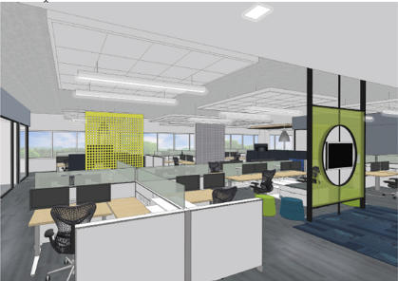
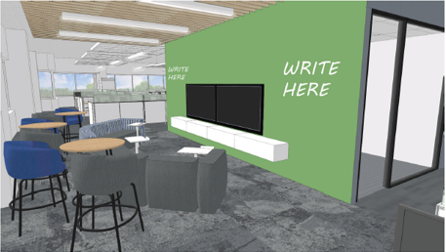
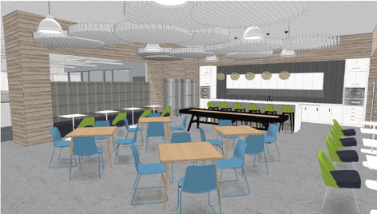

What are the Oracle Cloud Solution Hubs?
Reston
Austin
Branded Oracle Facilities (located in Oracle buildings)
With specially designed spaces to promote collaboration & innovation, and high-velocity delivery of industry cloud solutions
Staffed by NATD Solution Engineers
Bangalore
Map designed by Freepik

Slide 4











ORACLE Cloud
AWS
Azure
Agile Development
Open Source
Jenkins Chef Puppet
Cloud DevOps
Java
Who are the hub Solution Engineers?
Security
Integration
AppDev
New Hires
Full-stack Developers who “grew up” on the Cloud
Internal Transfers
Experienced Oracle SEs with Cloud Architecture backgrounds
IaaS
Full-stack and multi-pillar Cloud Development skills
Work experience in using competitive Cloud technologies & Oracle Cloud
Extensive training on latest Oracle Cloud technologies
Trained in ECAL and Cloud Accelerate
Work in Oracle Cloud Solution Hub locations (do not travel)
Info Mgmt
Analytics
Eng Sys
Servers
Intelligent * Talented * Skilled * Motivated * Community Oriented * Social * Energetic
Storage

Slide 5












What do the hub Solution Engineers do?
Scale delivery of NATD SE Services
Specialize in supporting SE Services requiring Cloud Solution Development and high-velocity, high-scale, high-reuse delivery
All the while INNOVATING
Demo Development
POC Development
Technical Workshops
Cloud Accelerate POVs
ECAL Support
Sizing & Config Support
RFx/Proposal Support
Industry Solutions
High-tech Solutions
Creative Designs
Streamlined tools with integrated best practice processes
Awareness Services
Opportunity Services
Demand Services
Success Services
In addition to building & leveraging our Digital Engagement Platform
Foundational Services
Teaming with ECAs, Platform Specialists, Bus Value Consultants, Industry Advisors, other hub SEs, account teams, customers, etc.
Website
Asset Repository
Work Mgmt & Collaboration Tools
Eng. Mgmt & Reporting
Enablement & Gamification

Slide 6



Oracle Cloud Solution Hubs enable
3 Layers of Innovation
Innovate Ourselves
SEaaS: Deliver packaged SE Services vs. SE Resources for greater quality & consistency of delivery
Solution Hubs: Create environments that promote collaboration, innovation & customer engagement
Digital Engagement Platform: Build infrastructure to support automation, collaboration, & scaled delivery
Innovate Our Solutions
Prototype next-generation Industry Cloud Solutions
Utilize latest Oracle Cloud technologies in inventive ways for “got to have” business solutions
Leverage the digital world to fully integrate solutions
Innovate Our Customers
Enable our customers to use Oracle’s complete Cloud stack to innovate their own business
Provide Innovation Workshops to our Customers
Lead by example by inviting customers into the Oracle Innovation Hubs to see what we are doing & how
Notes:
Agenda Slide. Layout topics in a Grid

Slide 7














Where do the Cloud Solution Hub SEs fit into the NATD Solution Engineering organization*?
*Orgs are dotted line to Hamidou Dia’s NATD SE Org.
Enterprise Cloud Architects & Business Value Consultants
Industry Advisors
Jim McKeighan
National* Edwin Upson | Enterprise Robin Link, Larry Welles, Alan Levine | Public Sector* Aaron Cornfeld
Customer Success Managers
Misha Logvinov
Cloud Platforms Joe Strada | Analytics* Adam Driver | Hardware* Chris Hause
Platform Specialists
Both PSs and Hub SEs are mapped to technology pillars within their orgs.
Security
Integration
AppDev
IaaS
Info Mgmt
Analytics
Eng Sys
Servers
Storage
Austin Bob Stanoch | Reston Girish Venkat | Bangalore Jack Kingsley
Hub SEs Hamza Jahangir
Oracle Digital* (Carl Griffin)
Solution Engineering Excellence (Tim Kelly)
Notes:
Agenda Slide. Layout topics in a Grid

Slide 8
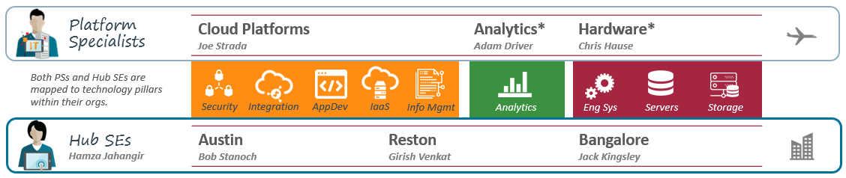
What is the Pillar Coverage across teams?
Technology Pillar | Pillar Specialist Mgr | Austin Hub Mgr | Reston Hub Mgr | Bangalore Hub Mgr
Analytics | Adam Driver |  | Tasbir Imam | Ranajoy Bose
AppDev | Joe Corvaia | Vaishali Gohel |  | Jack*/Induraj*
IaaS | Joe Corvaia | Moe Khan |  | Induraj Rangaswamy*
Info Mgmt | Paul Miller |  | Renuka Uttarala | Ram Purohit*
HW/Infrastructure | Chris Hause |  | Chandra Kallam | Induraj Rangaswamy
Integration | Craig Mikus | Aasheesh Naveen |  | Raj Raghavanunni
Security & ITOM | Security: Michael Freel, Mike Terra, Waymon Whiting; ITMO: Brian Hengen | Bob Stanoch* |  | Jack Kingsley*
*TBD - Temporary Manager
Notes:
Agenda Slide. Layout topics in a Grid

Slide 9

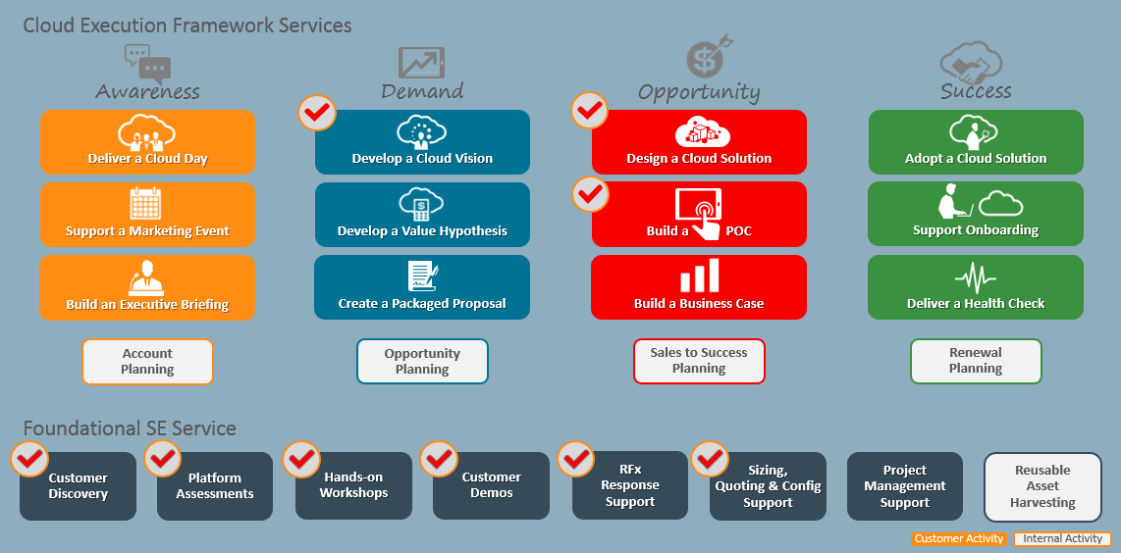
NATD Solution Engineering Service Catalog
How do Field SEs collaborate with Hub SEs?
What SEaaS Services do hub SEs support?
Pilot SE Service where Platform Specialists and/or Hub SEs are engaged.

Slide 10
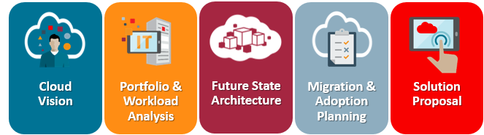
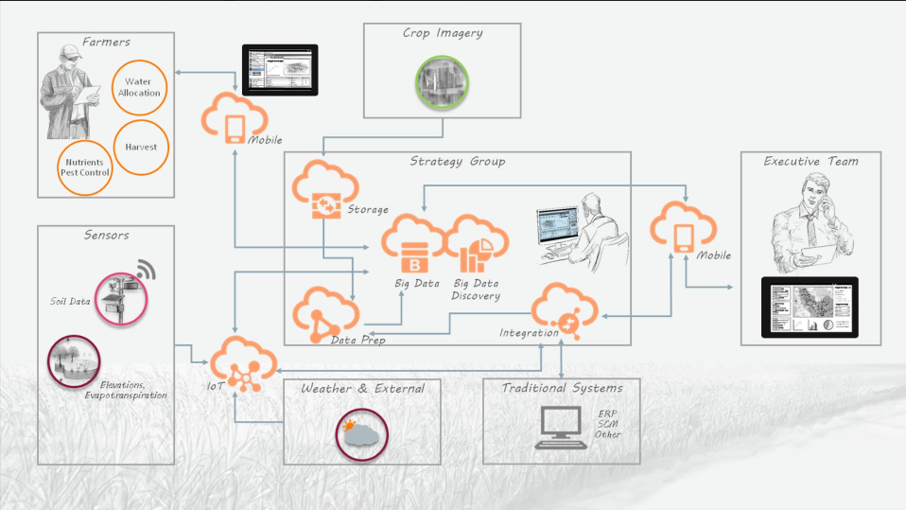
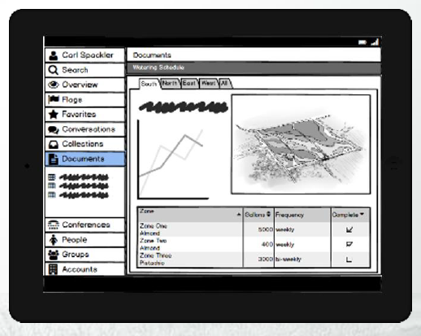
How do Field SEs collaborate with Hub SEs?
Example 1
Example 2
Develop a Cloud Vision SE Service using Cloud Accelerate
Design a Cloud Solution SE Service using ECAL
ECA Acts as “Ideator”
Storyboard & Notional Architecture
ECA *IA on Key Accts | JEP CVH* Cloud Vision* | CS Arch | Logical & Physical Archs |  | Solution PPT & Proposal
PS & Hub SE | Solution Demo Discovery | Sizing, Port & Workload Analysis | POV | Cloud Readiness Assessment
CSM |  | Ops Analysis |  | Adoption Plan Provision Intake Doc
BCV | CVH | Value Analysis |  |  | Bus Case
Platform Specialist & Hub SE Act as “Prototypers”
Solution Prototype
Note: This is an example of how responsibilities may be segregated by SE Role for an SE Service.

Slide 11
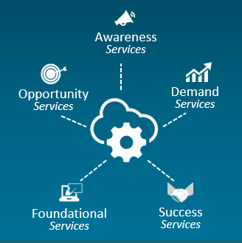
How do Cloud Solution Hub SEs get engaged?
1
3
Request for SE Resources
SCRM System
Request a Service from the SEaaS Catalog
Sales Rep
CPR | ECA
Specialist Rep
Analytics Rep
HW Rep
2
Create Engagement
Note: In Q1, this occurs outside of SCRM. Later in Q2, Services will be available for selection in SCRM.
Are Platform Specialists needed?
Do Hub SEs support this service?
Note: Initially, Hub SEs are assigned along with Platform Specialists for special on-the-job training.
5
4
Yes and Yes
Assign
Platform Specialist & Hub SE Resources
Platform
Hub
Platform Specialist
Hub SE
Process is coming.
Security
Integration
AppDev
IaaS
Info Mgmt
Analytics
Eng Sys
Servers
Storage

Slide 12
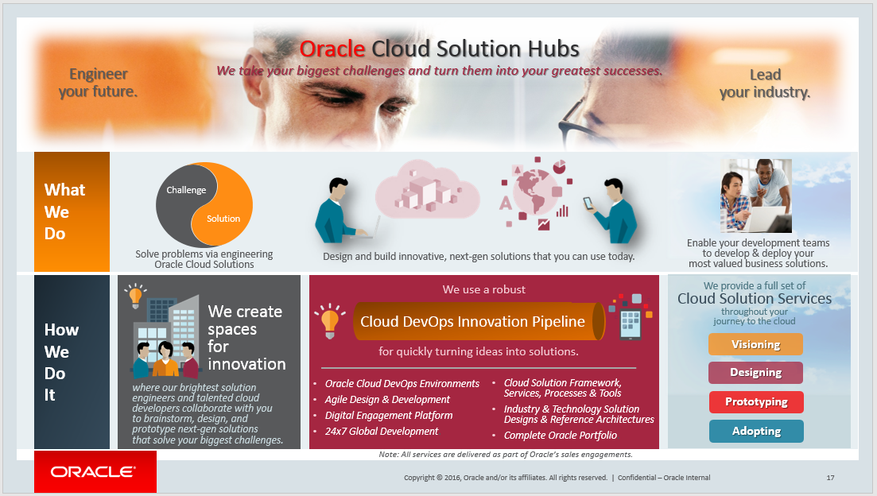
How will we market the Oracle Cloud Solution Hubs with our Customers?
The Oracle Cloud Solution Hubs is our external brand with customers – covering all that want to brand within NATD Solution Engineering
A coordinated Marketing rollout will begin with Oracle Open World, with an official Press Release to follow
We will have a web presence on Oracle.com & execute a Social Media plan
Customer visits to our hubs will begin in January.
Notes:
Agenda Slide. Layout topics in a Grid

Slide 13


How can I help our Cloud Solution Hubs succeed?
Become a Mentor
Contact Stephanie Tom to learn more about our Mentor Program.

Slide 14

Oracle Cloud Solution Hubs in Summary
Provides an environment for Cloud Innovation
Scales sales delivery of Industry Cloud Solutions
Injects the sales organization with new talent
Complements the SE Workforce skillsets and needs
Contact
Oracle Cloud Solution Website http://solutionengineering.us.oracle.com
Hamza Jahangir NATD Solution Engineering – Oracle Cloud Solution Hubs
Girish Venkat Reston Hub
Bob Stanoch Austin Hub
Jack Kingsley Bangalore Hub

Slide 15
Q.
A.

